Slide 1
Impressive gains were made in almost every measure since 2014
2017 KPI results compared to 2014 Baseline
+23
points
+15
points
+75%
+232%
+92%
-0.3
points
News share of voice
on Children’s Issues
Social Media share of voice on Children’s Issues
Social Media Reach
(global English)
Social Media Followers
(all channels)
Website Users
Returning
Website Visitors
+23
points
+25
points
+19
points
+13
points
-1.15
-0.04
% of coverage
with
Key Messages
% of coverage
with
UNICEF quotes
% of positive coverage
(online & print)
% of coverage with positive brand attributes
Facebook Engagement Score
(global English)
Twitter
Engagement Score
(global English)
Notes:
Slide with highlights of KPI scorecard, as details are explored in the rest of the report

Slide 2
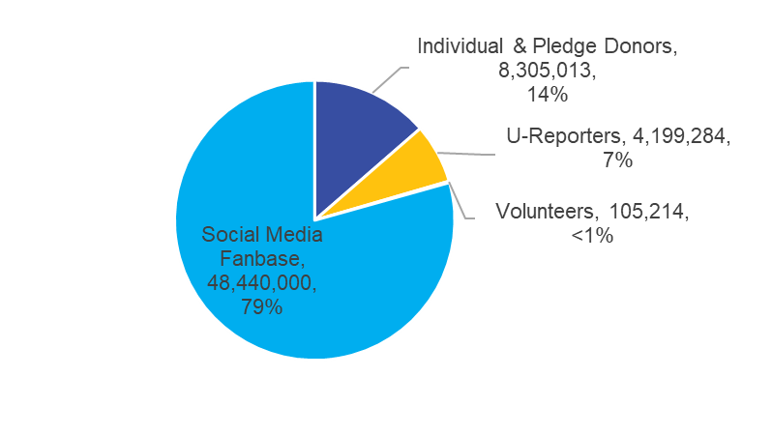
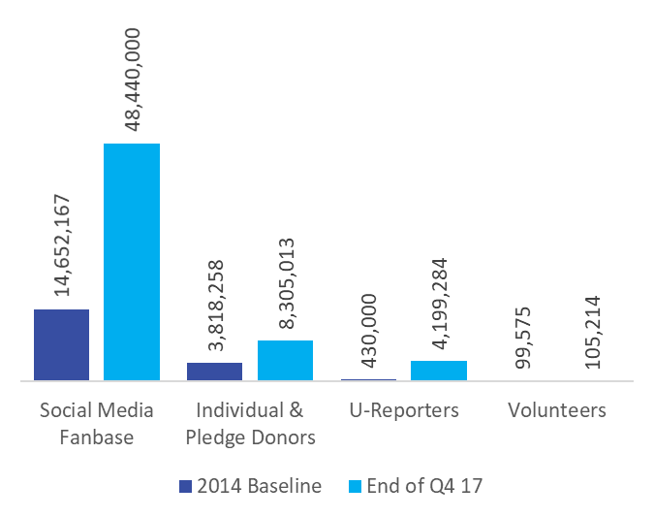
61,049,511 Engaged people worldwide by end of Q4 2017
UNICEF exceeded the target to engage 50 million supporters worldwide by the end of 2017 by 20%
End of Q4 2017
2014 Baseline vs. End of Q4 17
+42M (221%)
from 2014
* Data from 2017 Digital Report
Notes:
The target to engage 50 million supporters worldwide by the end of 2017 was exceeded by 20%; UNICEF had over 61 million supporters, including over 48 million followers on social media, over 8 million individual and pledge donors, over 4 million U-Reporters and 105 thousand volunteers.
There were over 15 billion opportunities to see online and print news about UNICEF. While not a guarantee, this high figure indicates that UNICEF is likely to have met its target of reaching one billion people

Slide 3
Quality of news coverage improved significantly
2017 Results
95%
Coverage with a
Key Message
52%
Coverage quoted a
UNICEF spokesperson
75%
Coverage was
Positive
+22% from 2014
+25% from 2014
+19% from 2014
Top 3 Brand Key Messages
Top 3 UNICEF spokespeople
Top Positive Themes
Notes:
Other performance highlights included a significant improvement in key message communication, with 95% of items including at least one key message, up from 73% in 2014. 52% of items included a quote from a UNICEF spokesperson, an improvement of 25 points from 2015. UNICEF met its target to achieve 75% positive coverage for 2017. UNICEF’s prominence in news articles also improved significantly, with UNICEF being mentioned in the headline or first paragraph in 51% of articles, up from the baseline of 23%

