Slide 1
AMEC International Communication Effectiveness Awards 2017
Samsung

Slide 2
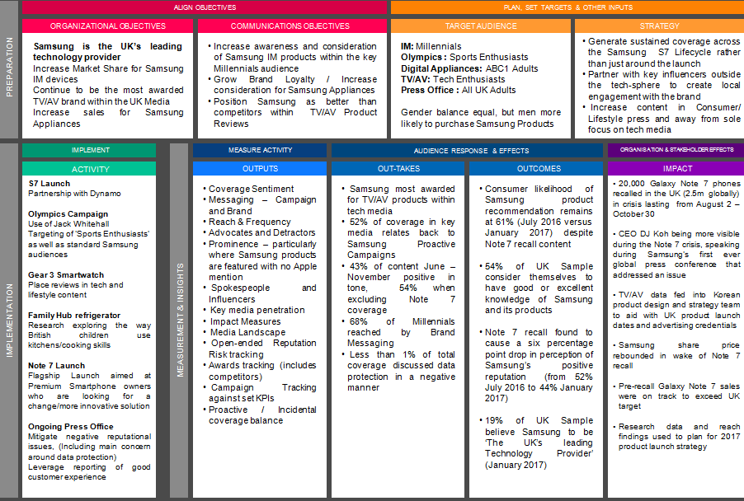
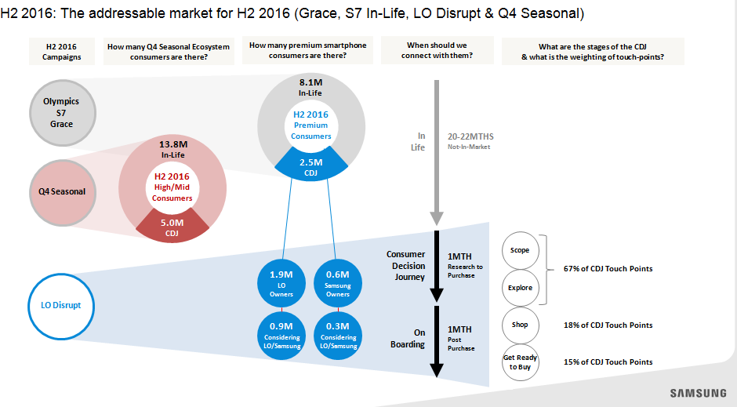
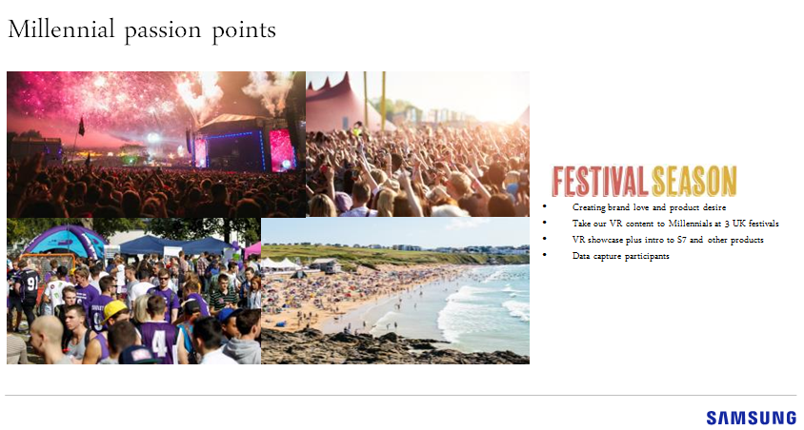
Campaign Planning linking to an Integrated Framework
Appendix 1

Slide 3
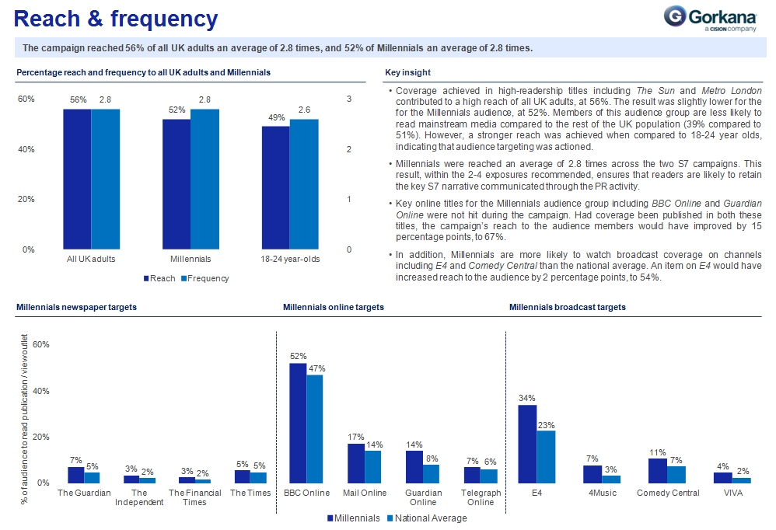
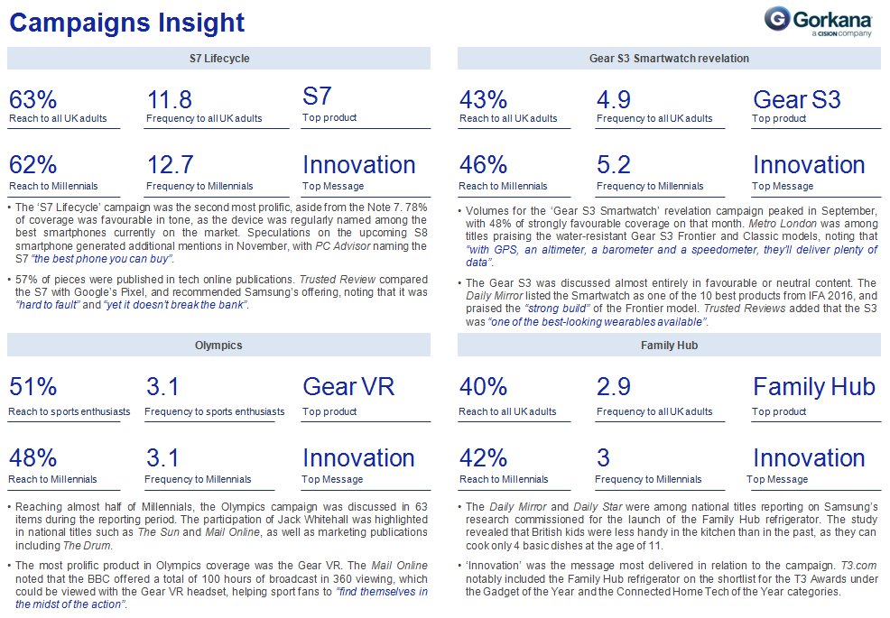
Focus on Quality & Actionable Insight
Appendix 2

Slide 4
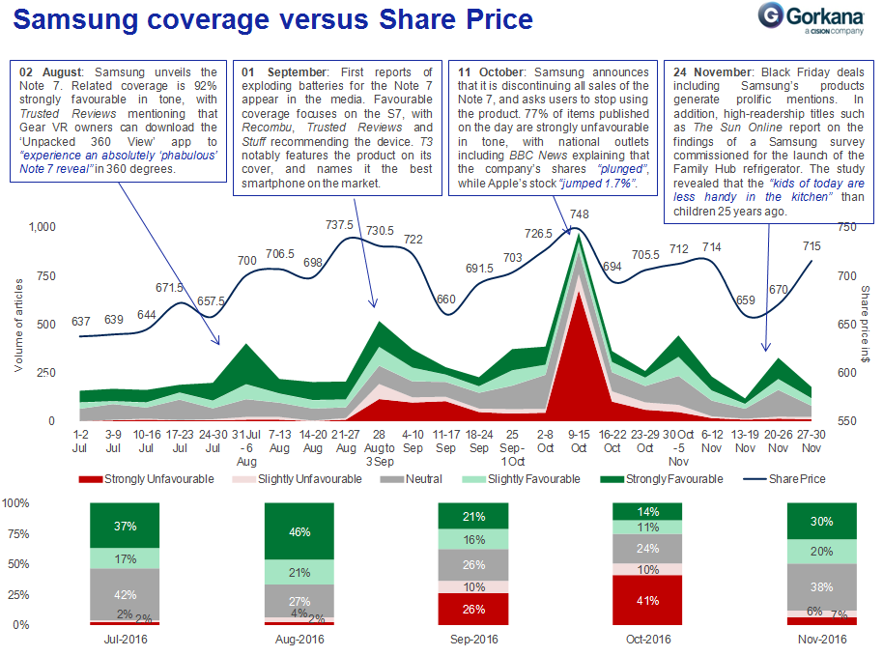
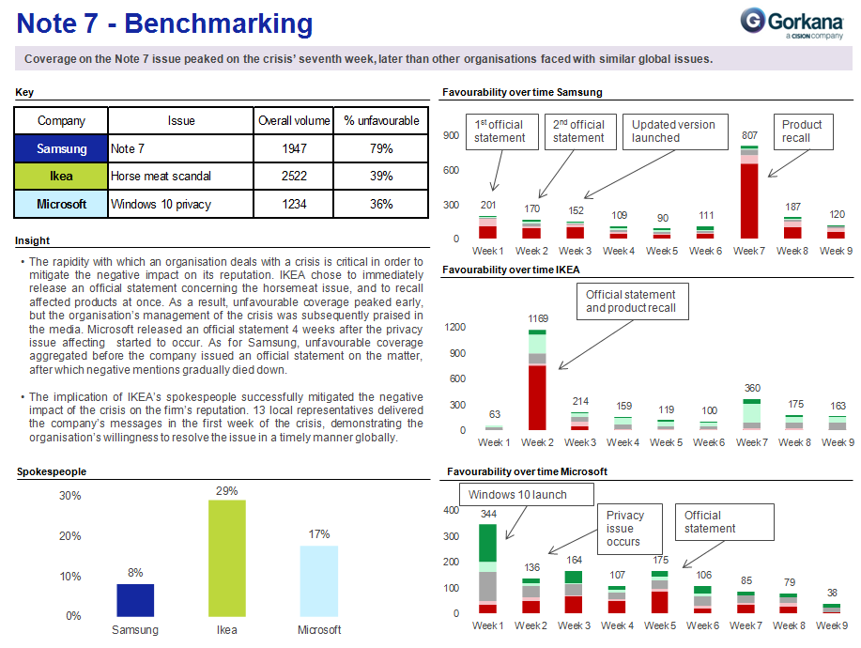
Exploring the Samsung Galaxy Note 7
Appendix 3

Slide 5
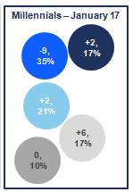
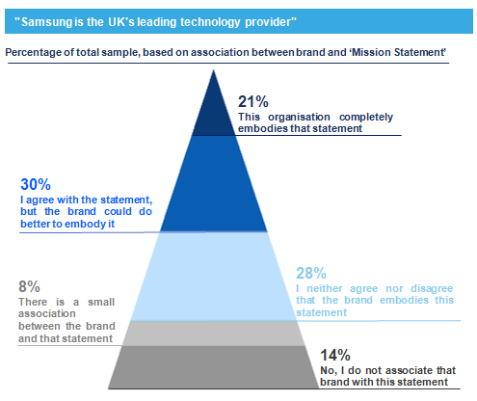
UK Reputation Research
Appendix 4

