Slide 1
AMEC International Communication Effectiveness Awards 2017
Stroke Association – New Era for Stroke

Slide 2
Stroke Association Integrated Evaluation Framework
Appendix 1
Lobby Government to continue the national Stroke strategy
Address “unacceptable” variations in stroke care and treatment on different areas of England
Raise awareness that Stroke is the UK’s third biggest killer
Direct people to sign a petition calling on the Government for a New Era Stroke strategy
General public
Charity supporters
Business leaders
Black and minority ethnic groups
Awareness of the impact of stroke is low among the general public leading to a lack of pressure on the Government to maintain a stroke strategy
Engage the public to raise awareness and to lobby the Government by signing the New Era petition for new stroke strategy.
2 phased approach – Make May Purple and World Stroke Day
Mainstream media engagement
Famous landmarks become purple
Launch of petition
Social media activity
Support from celebrities and health bodies
Over 600 proactive mainstream articles
51% of all adults reached with key audiences successfully targeted
88% of New Era articles delivered key message
‘Sign petition’ call to action increased from 14% to 28% over the campaign
11 million #NewEra impressions
Petition link shared more than 4,000 times
Awareness of campaign messages increased from 2% to 37%
Web visits and click-throughs strongly correlated with media coverage
More than 50,000 petition signatures
Government responded by safeguarding the existing strategy and agreed to debate
Campaign met objective of gaining a Parliamentary debate
Learnings from the campaign used to start lobbying for the debate
People significantly more aware of the scale and challenges of stroke survivors

Slide 3
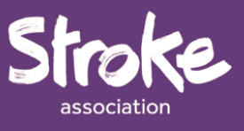
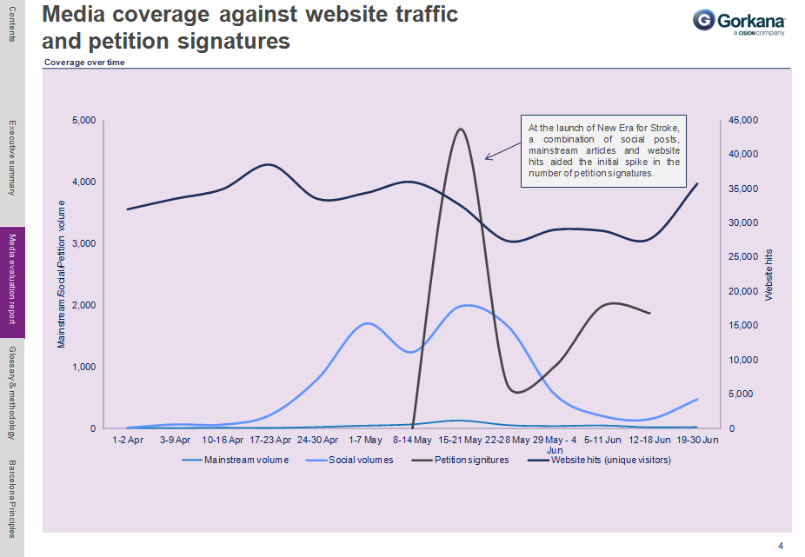
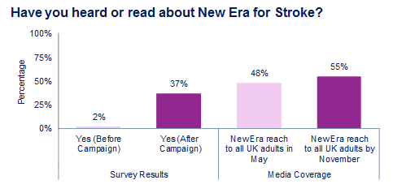
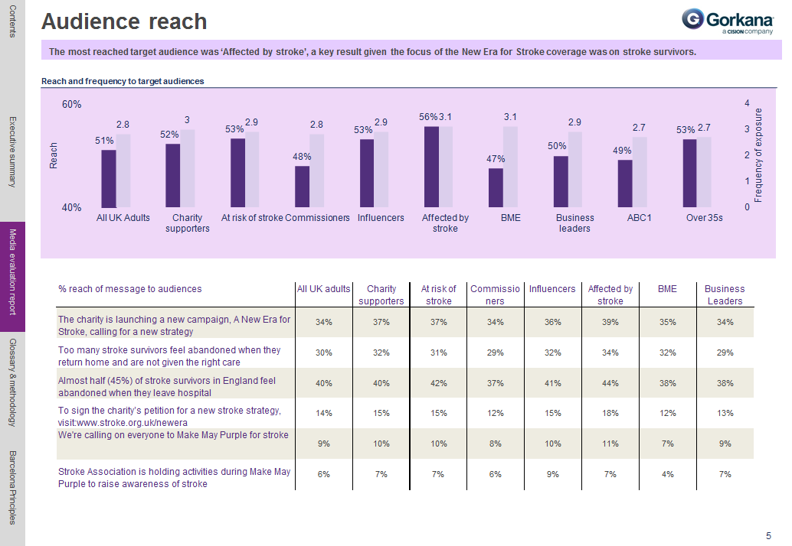
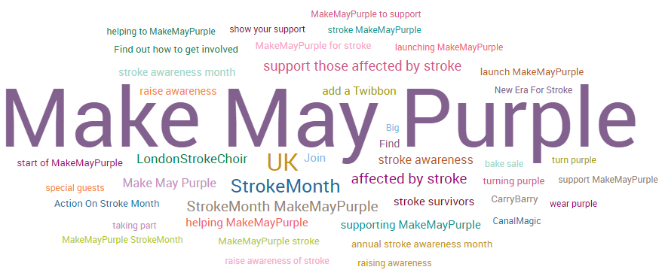
Appendix 2

Slide 4
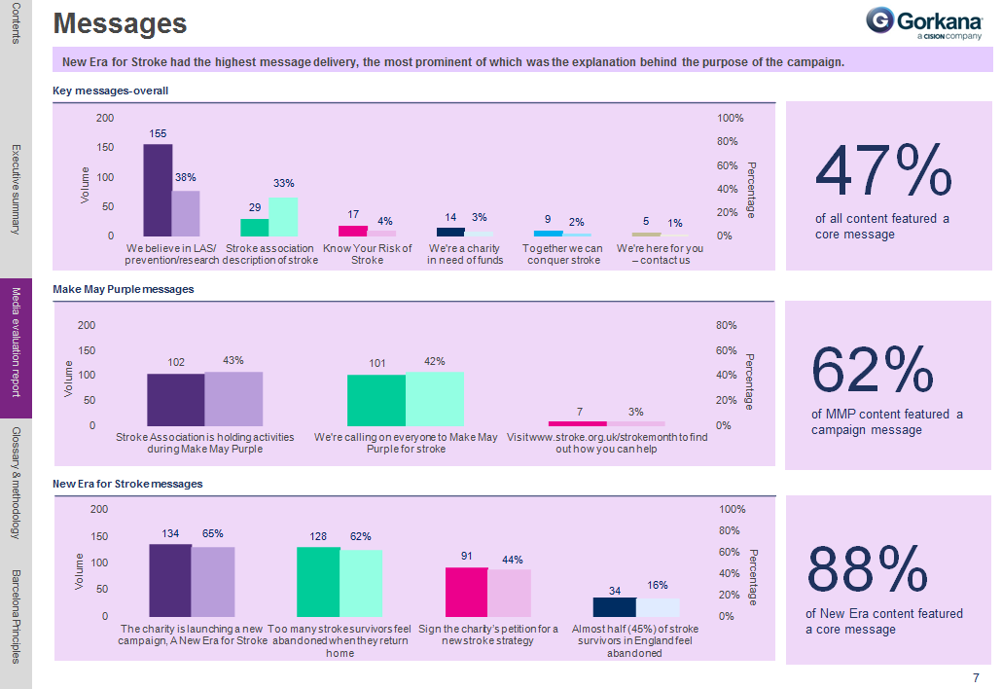
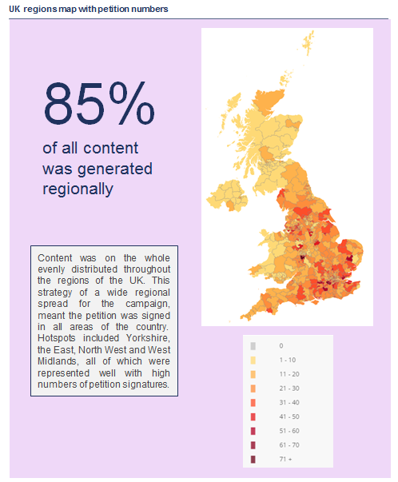
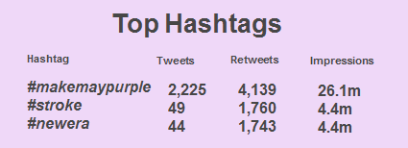
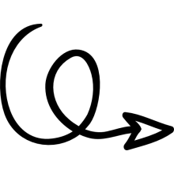
Appendix 3

Slide 5
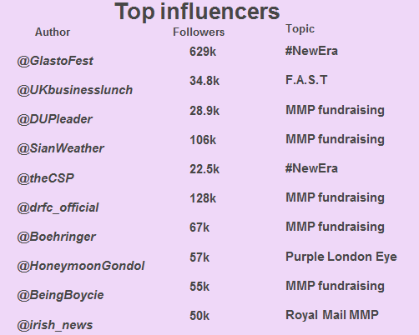
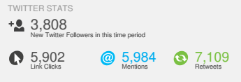
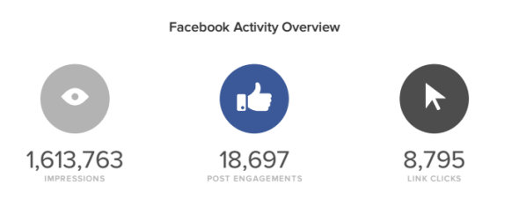
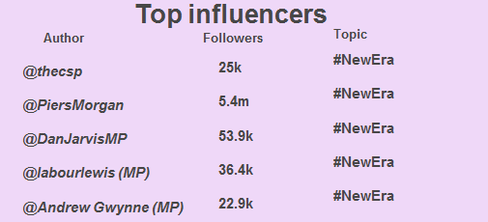
Appendix 4

