Slide 1
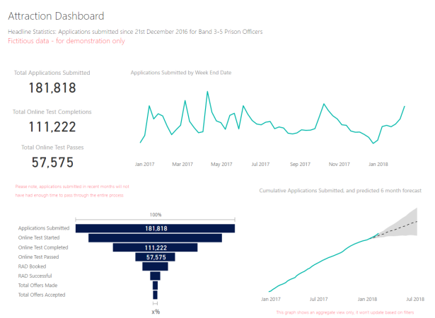
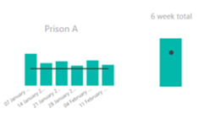
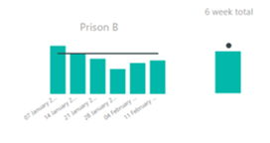
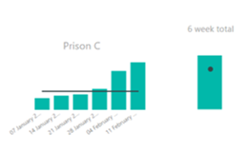
SUPPORTING MATERIAL: PowerBi
Please note: All data presented on this Powerpoint is fictitious and for illustrative purposes only.
Figure 1. PowerBi attraction dashboard showing headline statistics for applications submitted since Dec 2016 for Band 3-5 prison officer. This includes total number of applications submitted, total number of applicants completing online test, and total number of applicants who pass the online test.
Figure 2. Dashboard showing applications submitted in last six week compared to targets for priority sites (see black horizontal line). This dashboard also shows the cumulative totals for the previous 6 weeks of applications submitted compared to targets (see black dot).

Slide 2
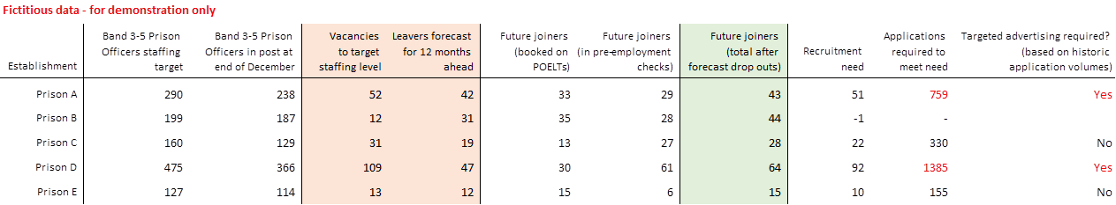
SUPPORTING MATERIAL: PowerBi and Surveys
2500
2250
2000
1750
Figure 3. PowerBi data used to calculate recruitment targets for each establishment. The main objective for the prison officer recruitment campaign is to recruit 2,500 prison officers by December 2018. However, the team had to consider multiple factors such as retention rates and establishment need when setting staffing targets. The gross figure for prison officer recruitment is far higher than 2,500. Retention rates mean the prison service has to recruit an additional 2,000 new officers each year to keep pace with attrition. The team has adopted a rigorous, granular approach in order to achieve campaign accuracy.
1500
1250
Fig. 4 YouGov perceptions of prisons survey July 2017 revealed that people were less likely to support a close friend or family member becoming a prison officer in the future compared to other public sector professions such as police officer.
1000
750
500
250
0

Slide 3
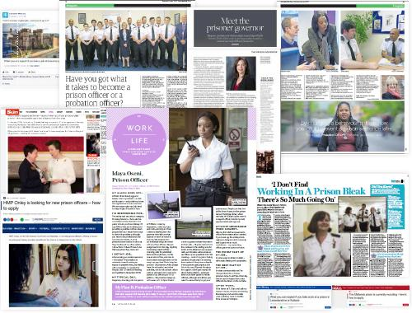
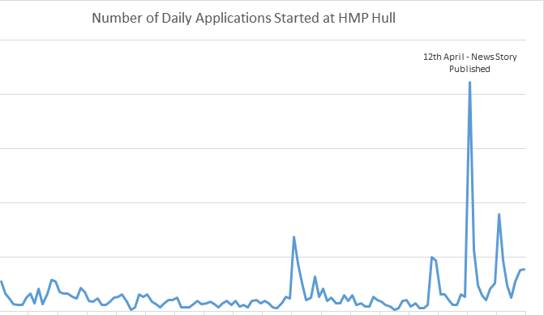
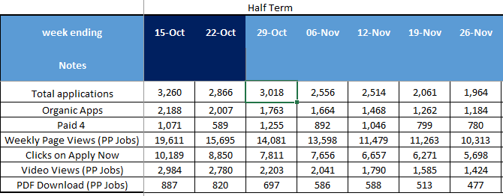
SUPPORTNG MATERIAL: Press Coverage and Analytics
Figure 6. Graph showing number of daily applications to HMP Hull. A spike in applications is clearly visible at the time of a news story publication, secured by our low cost/ no cost PR team, in the Hull Daily Mail.
Figure 5. Local and national press coverage secured by the low cost/no cost PR team to raise awareness of the prison officer role and what the role entails. National titles have included titles such as Stylist, SunEmployment, and Women’s Weekly. Local titles have included Eastern Daily Times and East Anglian Times.
Figure 7. Weekly media analysis put together by our insights team and external agency. This allows us to monitor the effectiveness of individual channels to drive applications and adjust our spend accordingly.

