Slide 1
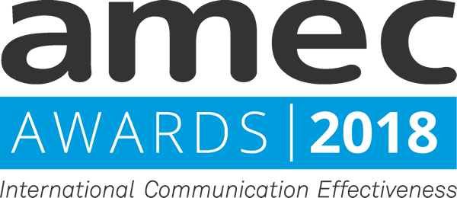
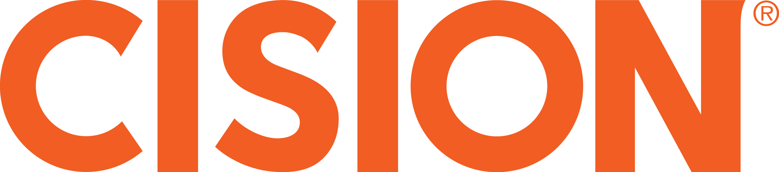
AMEC International Communication Effectiveness Awards 2018
Slimming World

Slide 2
Appendix 1: Slimming World Integrated Evaluation Framework
To help as many people as possible to achieve their dream weight
To become the world’s leading authority in weight management
To build success through customer delight
To increase the quantity and quality of media exposure and ensure consistency across multiple channels
To improve consumer perceptions of Slimming World
To drive engagement and membership
Women aged 30-44
Women aged 16-29
Men aged 25-50
Men who aren’t currently fitness enthusiasts
Women who aren’t currently fitness enthusiasts
Body positive messaging in light of SW research about social media photo worries.
Success stories of members who have achieved their dream weight
Demonstrating how the eating plan works – through recipes and eating plans
Encouraging people to seek support for successful weight loss by offering free membership
Regional push immediately after Christmas with photo opportunity - Peter Andre poses with Slimming World members at annual awards ceremony. Photo-led pieces with local members to ensure pick-up in large spread of regional media.
Early January - Social Research Piece - Talking about the worries people have in terms of unflattering photos of themselves featuring on social media. Questioning if this dents confidence and mean people cancel plans.
Annual Mr Sleek & Miss Slinky awards, with photocalls and pushes to national/consumer media.
Ongoing offers and healthy eating plans throughout January – targeting partners outlets Mirror/Record and women's consumers such as Best/Now. Designed to showcase flexibility and ease of Slimming World’s programme.
664 articles in 2017-2018 compared to 512 in 2016-2017 (a 30% increase)
50% increase in proactively generated coverage from last year with exposure sustained over a longer period of time
90% of coverage favourable in tone (increase from 81% last year)
79% of coverage featured a key messages (increase from 60% last year)
A 77% increase in coverage in regional media and a 41% increase in consumer media
Reach to Women aged 16-29 increased from 47% to 50% while reach to Women aged 30-44 increased from 46% to 49%
Share-of-voice against other weight loss organisations increased from 59% to 68%
78% of survey respondents had claimed that they read coverage about Slimming World. More than three quarters of these (77%) had said that they had read mostly positive coverage
The proportion of people who felt that Slimming World had a positive reputation increased from 74% to 79% over the course of the 2017-2018 campaign. (An 18 percentage-point increase in positive reputation over the last two years.)
Before the 2016-2017 campaign, 56% of people associated Slimming World with “achieving their ideal weight” which increased to 68% at the end of the campaign. After the 2017-2018 campaign this increased to 73%.
The proportion of people that say they are likely to use Slimming World increased from 45% to 51% in the 2017-2018 campaign.
Social media mentions saw a 38% increase from 94,000 before the campaign to 130,000 afterwards.
Website analytics showed that there were 9.4 million sessions on the Slimming World website in January 2018, a 17% year-on-year increase
74,466 new social followers and fans (compared to 10,659 during pre-activity period)
Total engagement on social channels: 478,000 (110% increase)
55 million impressions of the #SlimmingWorld hashtag (an increase of 49% from the pre-campaign period)
Strong engagement around key activities. Following Miss Slinky press call there were 732 social media posts & 256,000 video views. Visits to SW homepage up from 623 sessions the previous day to 4,461. Conversion rate of people searching for their ‘nearest Slimming World group’ increased significantly to 8.38% compared to long-term average of 0.25%.
Media team have been able to improve performance across a variety of KPIs using feedback from the measurement programme over the last two years
Consistent and improved results across key reputation measures in USurv survey results. Over the last two years the percentage of people associating Slimming World with achieving their ideal weight has increased from a half to three quarters while the percentage considering using Slimming World has increased from a third to over a half.
2017-2018 has seen significant engagement with members and potential members on social channels.
There have been significant increases in website traffic over the last two years. The spikes in traffic and conversion rates around key events is clear evidence of activity driving engagement.

Slide 3

Appendix 2: Media coverage – Year-on-year comparisons
Reach of proactive coverage to key audiences
Competitor SOV*
2016-2017
2017-2018
Message delivery
Volume and favourability
* Please note: This chart includes coverage from national and consumer print media only.
Proactive coverage over time
Media type
2016-2017
2017-2018

Slide 4
Appendix 3: Key reputation survey findings – Positive/negative news seen
Question 4. To what extent have the things you have heard, seen or read about Slimming World been positive or negative?
Pre-campaign by age group
Post-campaign by age group
Volume and favourability
Gorkana analysis insight
There was a significant increase in people’s exposure to positive news regarding Slimming World. The proportion of respondents who stated they believed ‘there have only really been positive things’, or that ‘there have been more positive things than negative’, grew from 53% in the pre-campaign period to 60% in the post-campaign one.
This change was particularly notable in terms of age differences, with the proportion of the youngest and the oldest respondents selecting these options increasing by 12 and 13 percentage points, respectively. The likelihood of the public to believe that Slimming World has either very positive or slightly positive reputation also grew, particularly among people aged 65 and over. The proportion of members of this group selecting these options increased from 69% to 89% in the post-campaign period.
The proportion of favourable coverage increased by seven percentage points, equivalent to 472 articles, with the volume of strongly favourable content increasing by 310 pieces. Nearly half (43%) of strongly favourable items in the post-campaign period were related to a Slimming World campaign.
The impact of the increasing communications output was also reflected in the proportion of the audience reached by content featuring Slimming World. People aged between 25 and 34 saw the highest increase, with the reach increasing by 12 percentage points for this group.
Audience reach

Slide 5
Appendix 4: Key reputation survey findings – Propensity to use Slimming World
Question 5. Whether you yourself are planning to lose weight or not, if you ever did decide to lose weight, how likely would you be to go to Slimming World – based on what you know about them?
Percentage of all UK adults reached
Gorkana reach:
The reach to all UK adults increased significantly in the post-campaign period, with an 11 percentage-point increase overall. This result was due to campaign coverage appearing in high-readership national titles, such as the Daily Mirror, Mail Online and Sun Online, which according to Gorkana UKPulse, are being read by 10%, 16% and 22% of UK nationals, respectively.
Gorkana analysis insight:
Gorkana analysis insight:
Overall volumes peaked on 4th January with 44 pieces, 25 of which conveyed the message that Slimming World is effective at helping people to lose weight and has evidence. Regional pieces focused on Peter Andre’s participation in the annual Slimming World Awards praising the work of local groups’ leaders. Coverage also featured case studies highlighting the successful weight-loss journeys of different people.
OTS peaked on the last day of the campaign period (26th January), due to strongly favourable coverage related to the ‘Mr Sleek 2018’ awards, featured on Mail Online and Mirror Online.
Volume and OTS over time
Note: Red line represents the start of Slimming World Christmas activity marked by the launch of Peter Andre Cuddle Test.

