Slide 1


MAKING MEASUREMENT MATTER

Slide 2
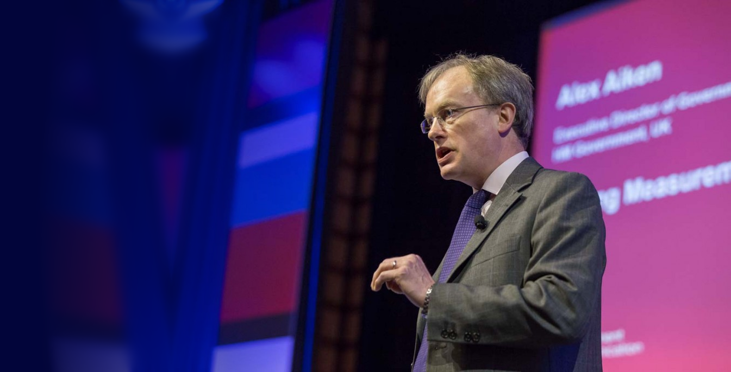
“Make measurement a mainstream part of every PR programme and campaign. It’s not a nice to have.
It’s an integral part
of communications.”
Alex Aiken
Executive Director of Communications, UK Government
- AMEC Global Summit, 2015

Slide 3
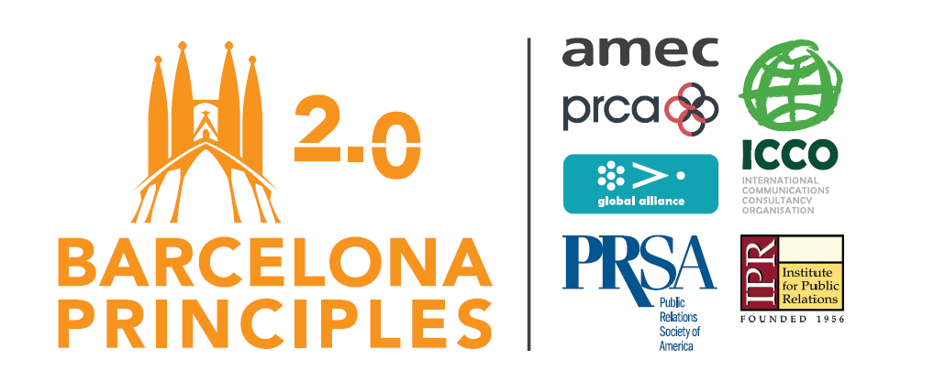
A transformative idea that made people sit up
Our Original Goal:
End years of debate as to whether metrics such as AVEs should be used, and provide a worldwide industry standard.

Slide 4
The Seven Barcelona Principles
Original (2010) | 2.0 (2015)
Importance of Goal Setting and Measurement Measuring the Effect on Outcomes is Preferred to Measuring Outputs The Effect on Business Results Can and Should Be Measured Where Possible Media Measurement Requires Quantity and Quality AVEs are not the Value of Public Relations Social Media Can and Should be Measured Transparency and Replicability are Paramount to Sound Measurement | Goal Setting and Measurement are Fundamental to Communication and Public Relations Measuring Communication Outcomes is Recommended Versus Only Measuring Outputs The Effect on Organizational Performance Can and Should be Measured Where Possible Measurement and Evaluation Require Both Qualitative and Quantitative Methods AVEs are not the Value of Communication Social Media Can and Should be Measured Consistently with Other Media Channels Measurement and Evaluation Should be Transparent, Consistent and Valid

Slide 5
Four fires driving measurement agenda
It’s about being data-smart
Procurement specialists demanding measurement
It sets agencies apart BUT ..you need to make a commitment!
Greater interest in measurement by PR industry than ever before

Slide 7
Now its about being ‘data smart’

Slide 8
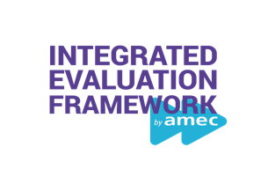
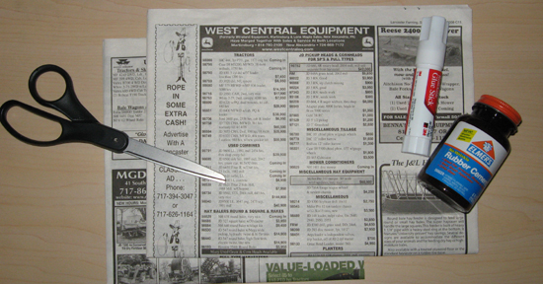
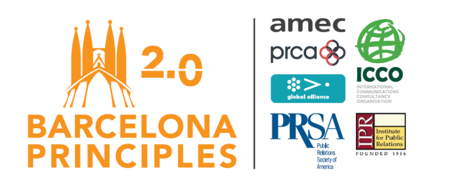
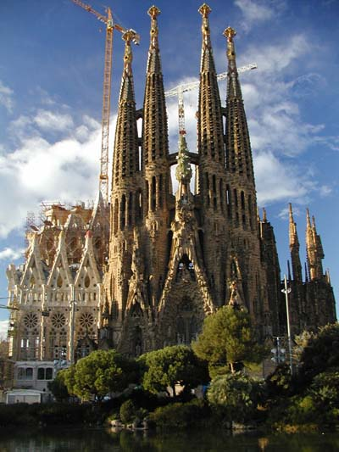
Evolution in measurement
2000
2010
2015
2017
AMEC Integrated Evaluation Framework (IEF)
Clip Books…
  Yesterday!
  Time Consuming
Barcelona Principles
Barcelona Principles 2.0

Slide 9
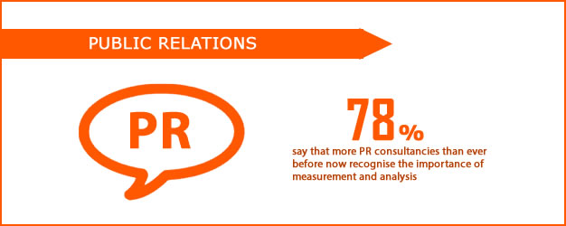
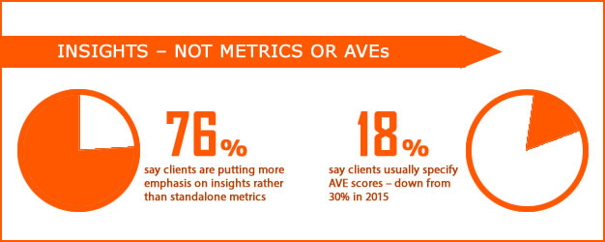
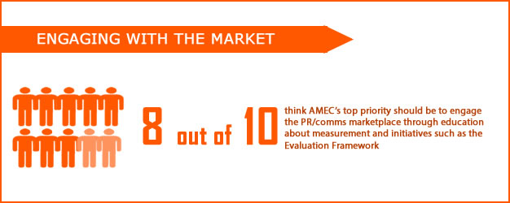
Global measurement trends
62%
81%

Slide 10
Commitment: - why measure
Serve clients
Clients want proof what you do is working
Grow Business
Measurement can help you win business
Protect the business
If you can’t show results, other firms will

Slide 11
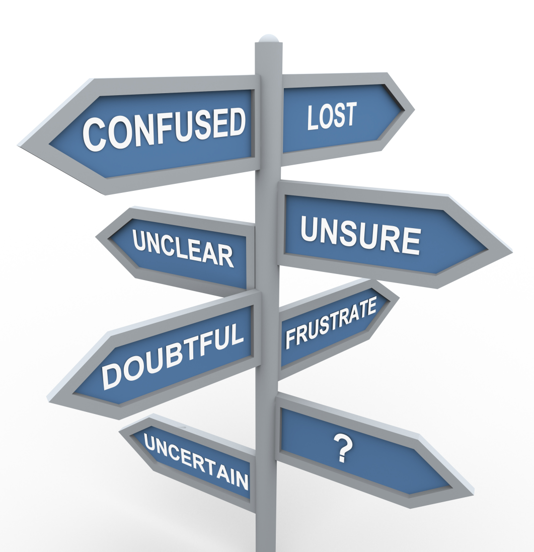
Using the right language
Outputs
What you put out that reaches and engages your target audiences
Outtakes
What audiences take out of and do with your communication
Outcomes
What effect or impact the communication has on the target audiences

Slide 12
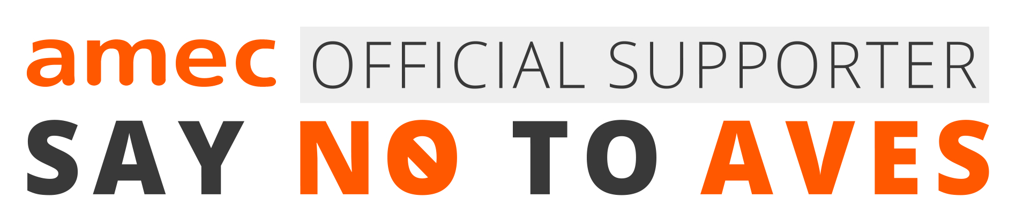
The fight to eradicate AVEs!
In 2017 we will spend 60% of our annual budget on education
Major new campaign is “Say No to AVEs”
Inviting all international trade associations to stop use of AVEs in PR Awards schemes.
Improvements made to AMEC free Integrated Evaluation Framework to make it an easier to use replacement for AVEs.
AMEC has now created a global online educational resource centre to show why the metric is invalid

Slide 13
Why Ban AVEs?
Cannot capture the outcome of a PR campaign, limiting PR to its placements in the media.
Cannot measure the variety of messages delivered in the media in relation to messages in advertisements.
Cannot measure the value of keeping a client out of the media spotlight.
Cannot properly distinguish between placements in noteworthy columns or sections of a publication and generic or less desirable areas of a publication.
Cannot measure social media forms, such as blogs and message boards.
Because an AVE is the Cost of Advertising, not the Value of Earned Media

Slide 14
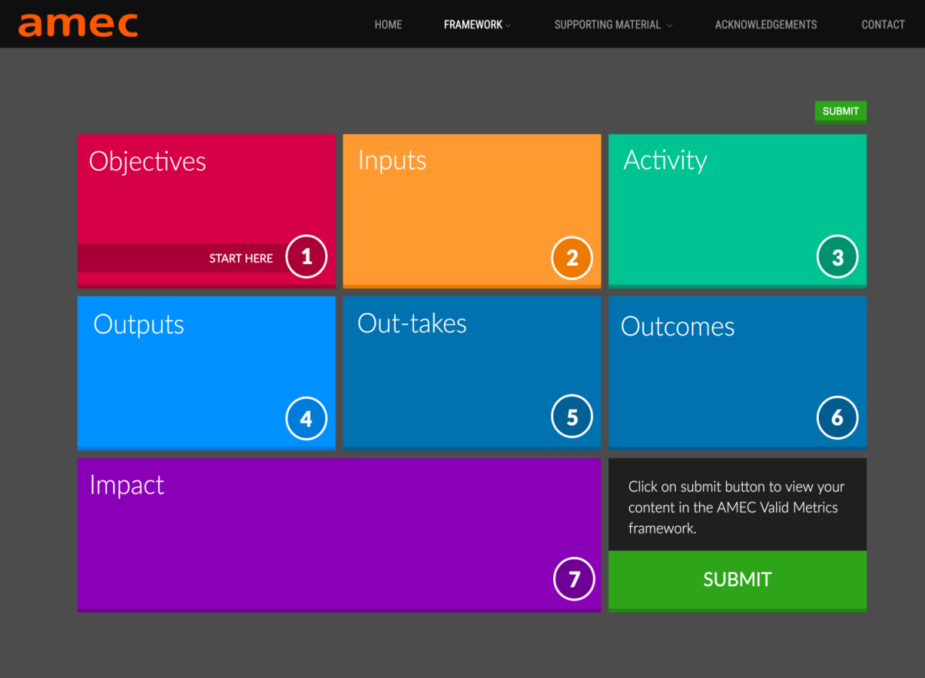
New AMEC Framework free to use
Improvements made to make Integrated Evaluation Framework easier than ever to use
Framework shows how to ‘operationalize’ the Barcelona Principles.
Demonstrates how to turn Principles into action and prove value of Your work.
See video tutorial. https://amecorg.com/amecframework/framework-tutorial/

Slide 15
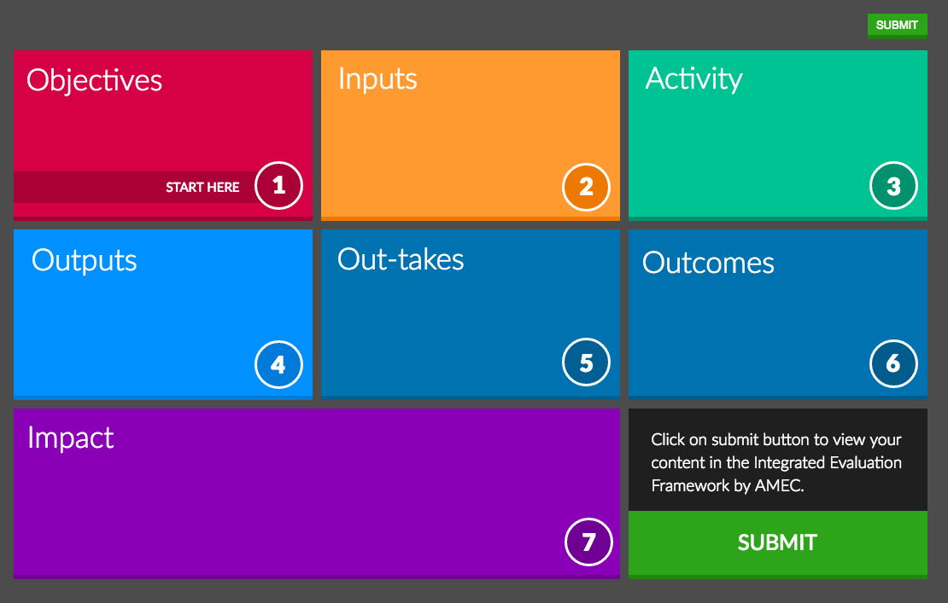

Slide 16
What does the new framework do?
Guides you through the process from aligning objectives to establishing a plan, setting targets and measuring outputs, outtakes, outcomes and impact of your work.
At each step it provides additional i drop downs for information and suggests potential approaches and metrics.
Provides consistent and credible approach that works for organizations of all sizes
Anyone can use it, it is free and non-proprietary.
Allows you to save your work and return to it in draft.
Launched in June 2016 at the AMEC Summit, London

Slide 17
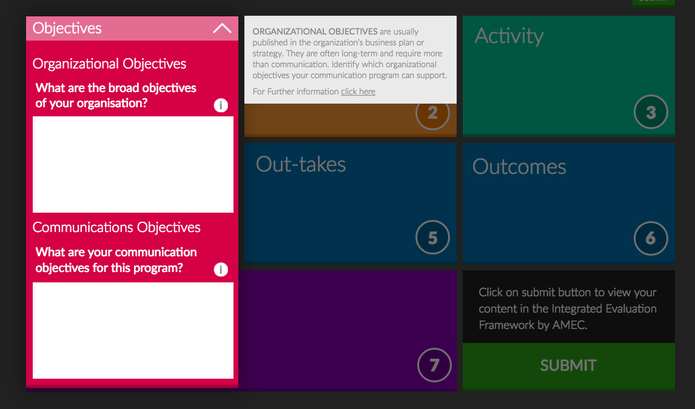
How the Framework works

Slide 18
Making measurement matter
  www.amecorg.com/resource-centre
    Information freely available and downloadable
Video presentations
  Case Studies
    http://amecorg.com/amecframework/home/framework/interactive-framework-2/
    Framework tutorial. https://amecorg.com/amecframework/framework-tutorial/.
    22 Reasons not to use AVEs. https://amecorg.com/wp-content/uploads/2017/06/22-reasons-to-say-no-to-AVEs-by-Richard-Bagnall-11-June-2017.pdf
Thank you for your interest

